Slide 1

News-To-Market
Group 2
ISSS610:
Applied Machine Learning
Asmit Adgaonkar Brijesh Gupta
Clarence Tan Yan Zhi
Debasish Behera
Eric Prabowo Cundomanik
Franky Eddy

Slide 2



Project Scope
Tools

Slide 3
Project Scope
Motivation
Apply machine learning techniques to make a data oriented decision
Make use of external data to help predict the market data and its movements
Combine the concepts of machine learning and text analytics to gain better insights both from market data and text data (i.e. News and Forums)
Data
RedditNews.csv: Historical news headlines from Reddit World News Channel.
DJIA_tables.csv: Daily rates of Dow Jones Industrial Average (DJIA) from date range 08/08/2008 to 01/07/2016.
Combined_News_DJIA.csv: Combined dataset of both Reddit News and DJIA tables dataset. Label reflects the binary classification as below:
"1" when DJIA Adjusted Close value rose or stayed the same
"0" when DJIA Adjusted Close value decreased.

Slide 4
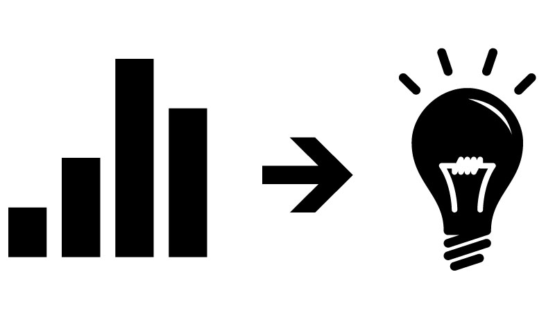
Objectives

Slide 5
Objectives: Using Financial news to predict stock market movement
STOCK MARKET
Corpus Representation as BOW.
NLTK
BOW
Phrases can have an impact different than single words
Corpus Representation as n-gram
N-gram
Co-occurring words
Filter out the unwanted noise in the news
Extract the most meaningful set of topics for each article
Topic Model
Suitable Topics
Sentiment Analysis
Positive / Negative News
Understand if the sentiment connotated by the news has any impact on the stock market
NBO

Slide 6

Approaches

Slide 7
Approaches
Data Preparation
Tokenization
Stop words removal
Dictionary creation
Tf-idf weighting
Sentiment Analysis
Elbow Analysis on k-means clustering
Exploratory Analysis
Model Fitting
LDA

Slide 8
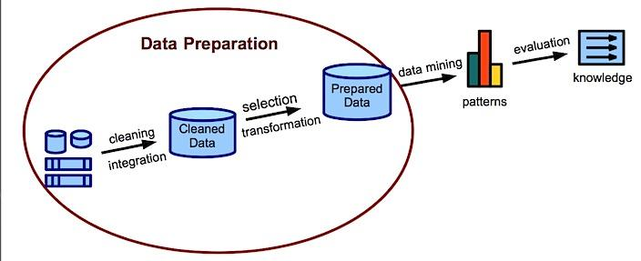

Data Preparation

Slide 9
Data PREPARATION
Corpus Generation
BOW
Tf-idf; N-gram:1
BOW
Tf-idf; N-gram:2
Stopwords Removal
Representation
BOW with POS tags
Stemming
BOW
Tf-idf; N-gram:2 + Sentiment

Slide 10

Exploratory Analysis

Slide 11
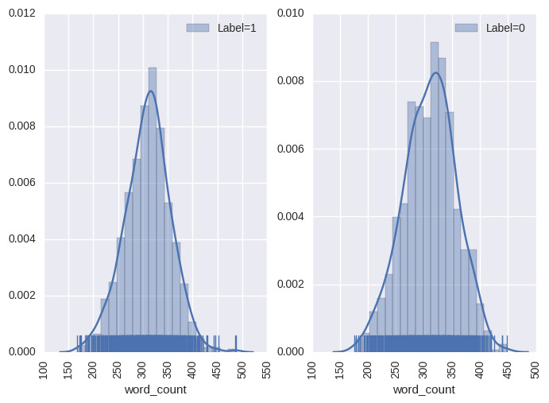
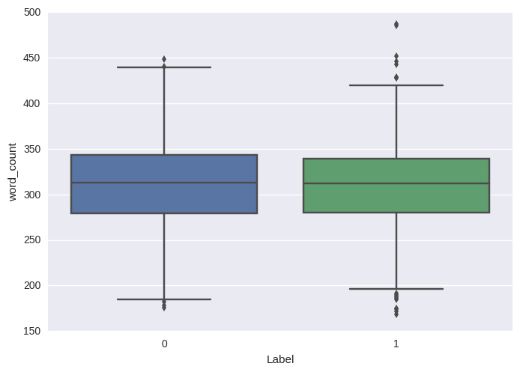
Word Count
Word Count Histogram
Word Count Box Plot
Average word count is centered around 300
Label = 0 seems slightly right skewed
Distribution of word count is close to normal distribution
More variation of the word counts can be seen for label = 1

Slide 12
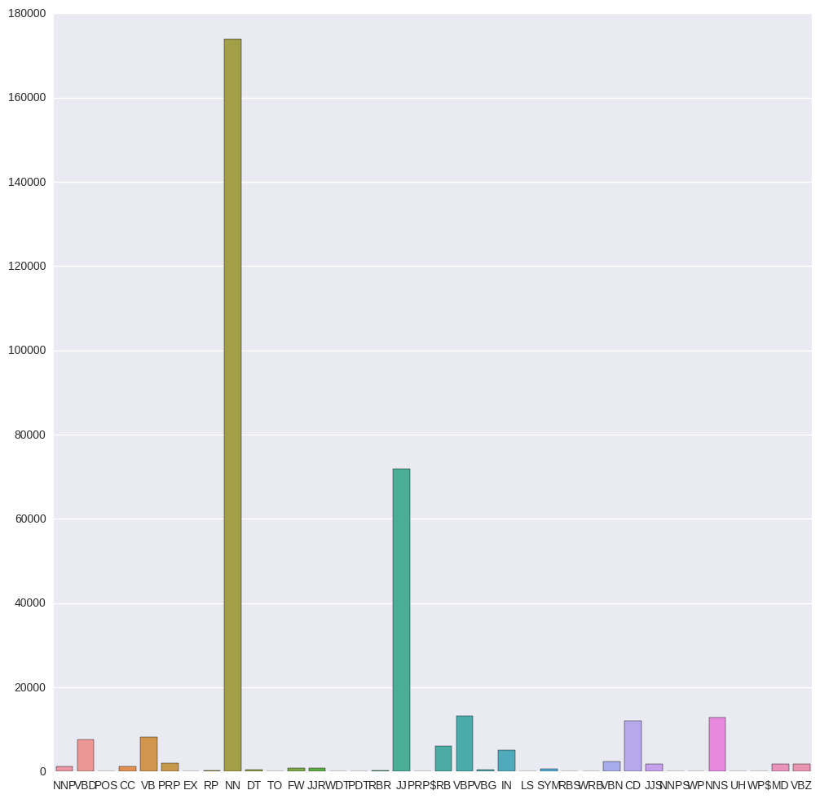
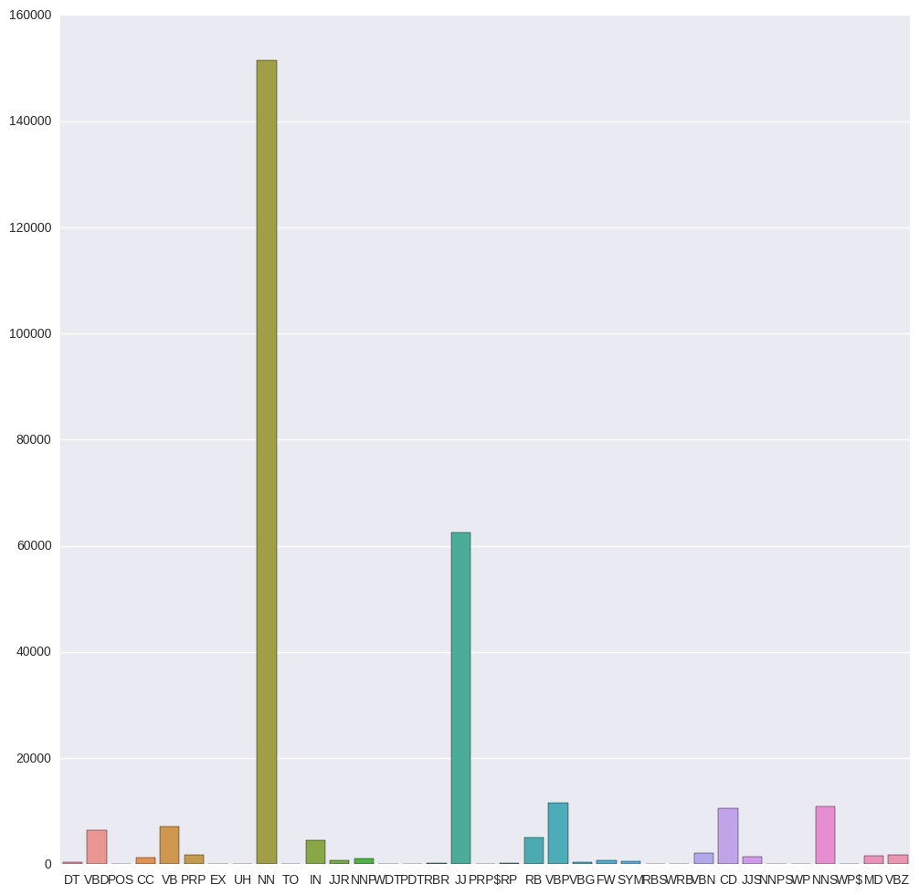
Distribution of POS Tags
Label = 1
Label = 0
Similar distribution of POS tags for both labels
Noun and adjective are the most dominant POS tags

Slide 13
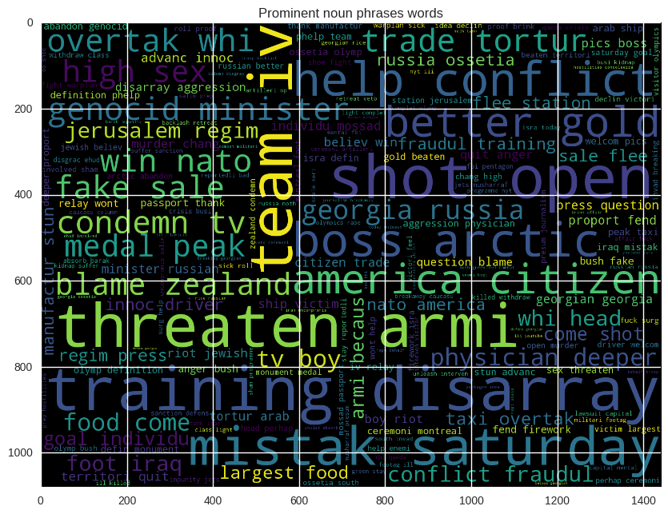
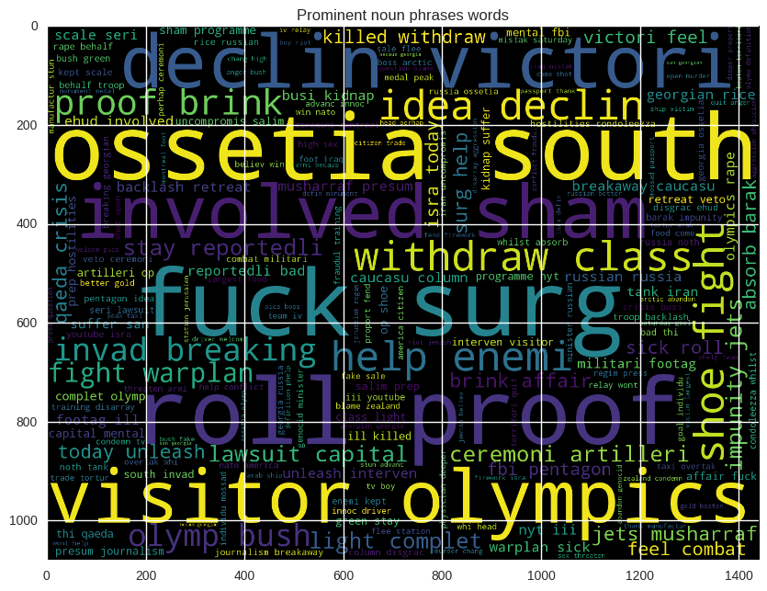
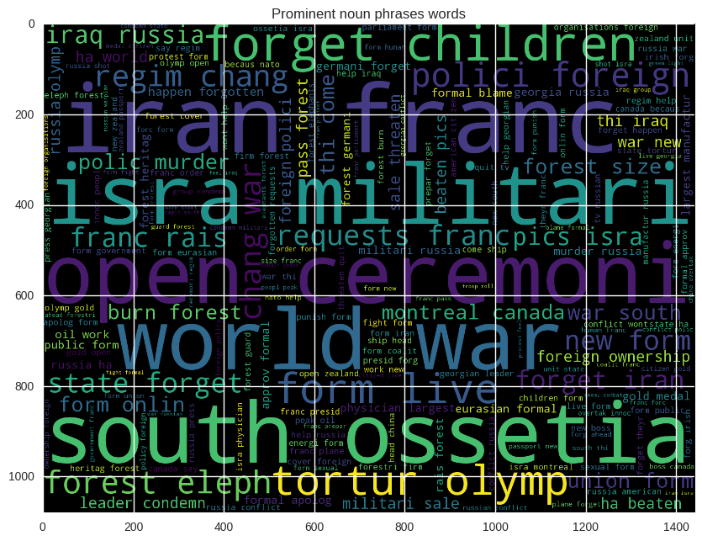
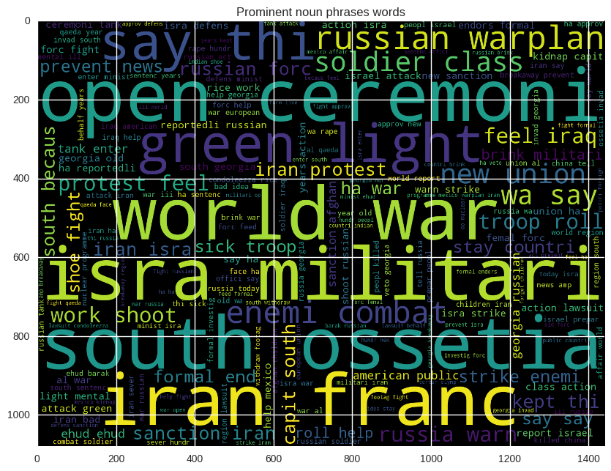
Word Cloud
Tf-idf ; n-gram: 1 ; Label = 1
Tf-idf; n-gram:1 ; Label = 0
Tf-idf; n-gram: 2 ; Label = 1
Tf-idf; n-gram: 2 ; Label = 0

Slide 14


Model Fitting

Slide 15

Models
Linear Model
KNeighborsClassifier
MultinomialNB
DecisionTreeClassifier
RandomForest
AdaBoostClassifier
BaggingClassifier
GaussianNB
SVC

Slide 16
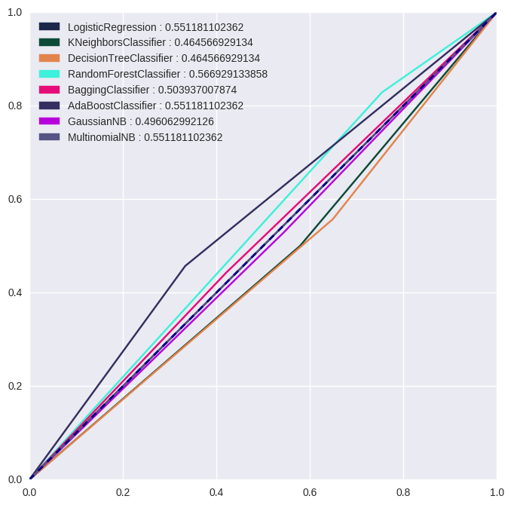
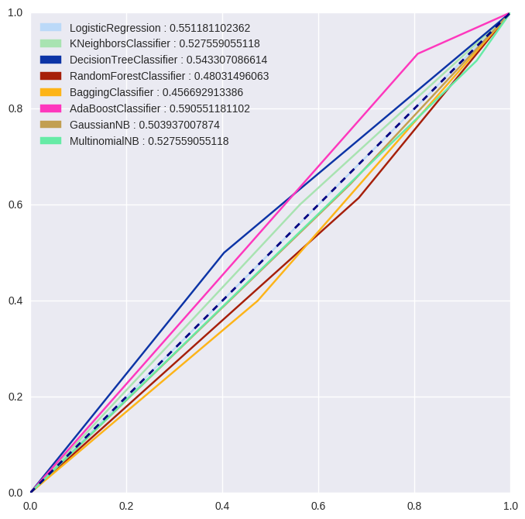
Model Performance
ngram = 1, with tf-idf representation
ngram = 2, with tf-idf representation
Model | Accuracy | F1 | Precision | Recall
Logistic Regression | 0.551181 | 0.710660 | 0.551181 | 1.000000
Kneighbors Classifier | 0.464567 | 0.507246 | 0.514706 | 0.500000
Decision Tree | 0.464567 | 0.534247 | 0.513158 | 0.557143
RandomForest | 0.566929 | 0.678363 | 0.574257 | 0.828571
Bagging | 0.503937 | 0.496000 | 0.563636 | 0.442857
AdaBoost | 0.551181 | 0.528926 | 0.627451 | 0.457143
GaussianNB | 0.496063 | 0.536232 | 0.544118 | 0.528571
MultinomialNB | 0.551181 | 0.710660 | 0.551181 | 1.000000
Model | Accuracy | F1 | Precision | Recall
LogisticRegression | 0.551181 | 0.710660 | 0.551181 | 1.000000
KNeighborsClassifier | 0.527559 | 0.583333 | 0.567568 | 0.600000
DecisionTree | 0.543307 | 0.546875 | 0.603448 | 0.500000
RandomForest | 0.480315 | 0.565789 | 0.524390 | 0.614286
BaggingClassifier | 0.456693 | 0.448000 | 0.509091 | 0.400000
AdaBoostClassifier | 0.590551 | 0.711111 | 0.581818 | 0.914286
GaussianNB | 0.503937 | 0.588235 | 0.542169 | 0.642857
MultinomialNB | 0.527559 | 0.677419 | 0.543103 | 0.900000
RandomForest has the highest accuracy (0.566929)
AdaBoost Classifier has the highest accuracy (0.590551)

Slide 17
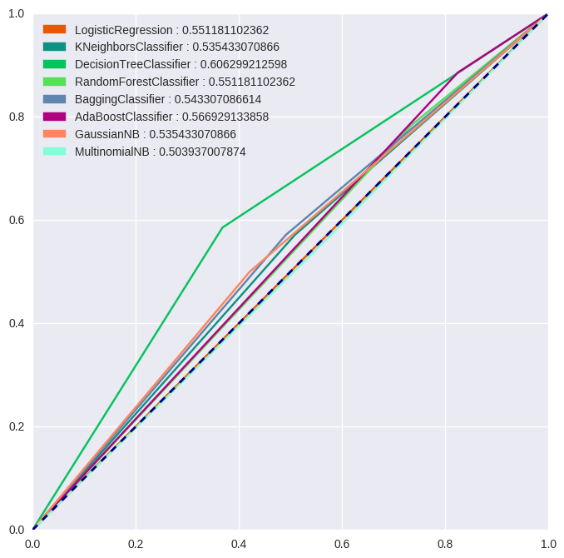
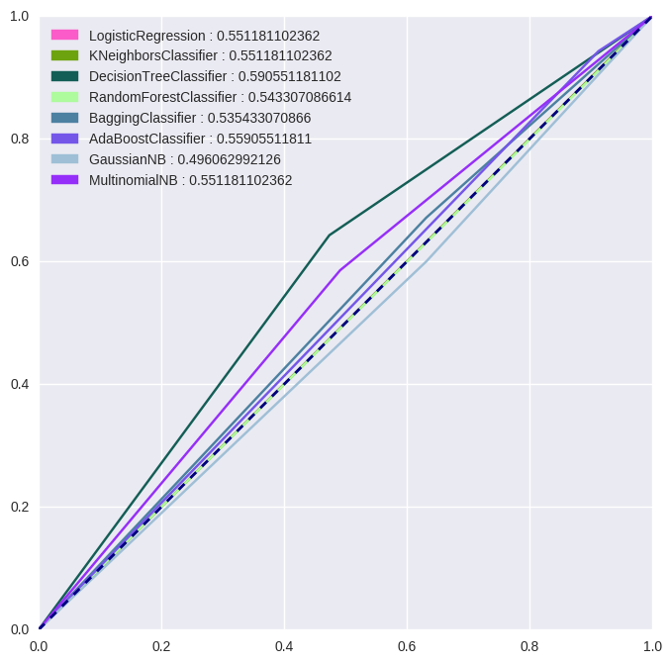
Model Performance (USING POS TAGS)
ngram = 1, with tf-idf representation
ngram = 2, with tf-idf representation
Model | Accuracy | F1 | Precision | Recall
Logistic Regression | 0.551181 | 0.710660 | 0.551181 | 1.000000
Kneighbors Classifier | 0.535433 | 0.575540 | 0.579710 | 0.571429
Decision Tree | 0.606299 | 0.621212 | 0.661290 | 0.585714
RandomForest | 0.551181 | 0.658683 | 0.567010 | 0.785714
Bagging | 0.543307 | 0.579710 | 0.588235 | 0.571429
AdaBoost | 0.566929 | 0.692737 | 0.568807 | 0.885714
GaussianNB | 0.535433 | 0.542636 | 0.593220 | 0.500000
MultinomialNB | 0.503937 | 0.559441 | 0.547945 | 0.571429
Model | Accuracy | F1 | Precision | Recall
LogisticRegression | 0.551181 | 0.710660 | 0.551181 | 1.000000
KNeighborsClassifier | 0.551181 | 0.710660 | 0.551181 | 1.000000
DecisionTree | 0.590551 | 0.633803 | 0.625000 | 0.642857
RandomForest | 0.543307 | 0.691489 | 0.550847 | 0.928571
BaggingClassifier | 0.535433 | 0.614379 | 0.566265 | 0.671429
AdaBoostClassifier | 0.559055 | 0.702128 | 0.559322 | 0.942857
GaussianNB | 0.496063 | 0.567568 | 0.538462 | 0.600000
MultinomialNB | 0.551181 | 0.589928 | 0.594203 | 0.585714
Decision Tree has the highest accuracy (0.606299)
Decision Tree has the highest accuracy (0.590551)

Slide 18

Sentiment Analysis

Slide 19
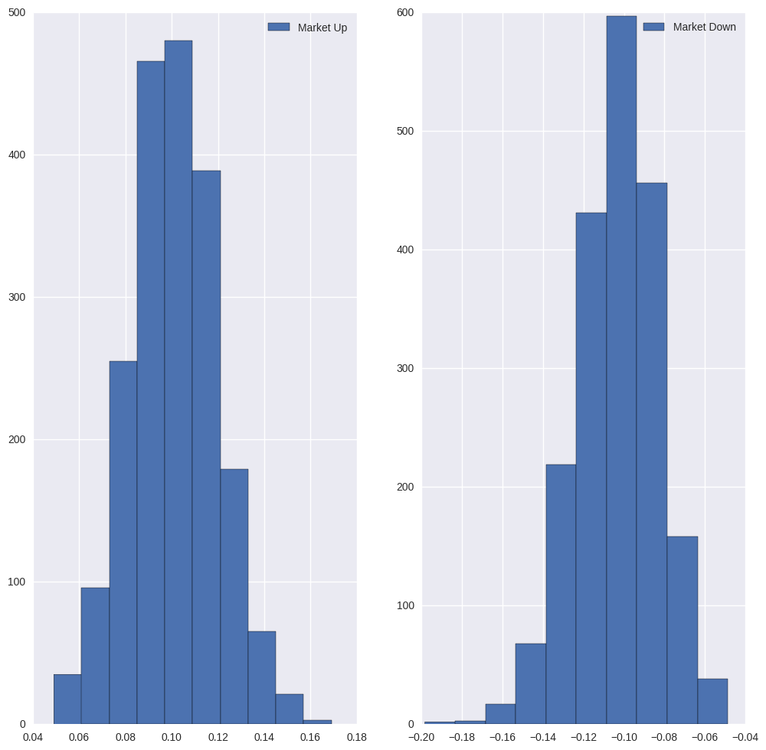
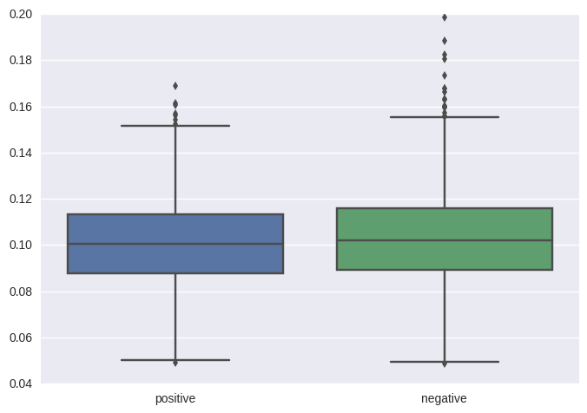
Exploratory on Sentiment Analysis
Sentiment Histogram
Sentiment Boxplot
Similar distribution of sentiment score for both labels
More variation for negative sentiment

Slide 20
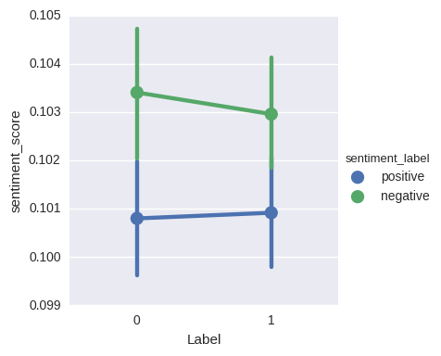
Sentiment SCORE vs MARKET MOVEMENT
Average negative sentiment score is decreasing when the market is moving up (label = 1)
Average positive sentiment score is increasing when the market is moving up (label = 1)

Slide 21
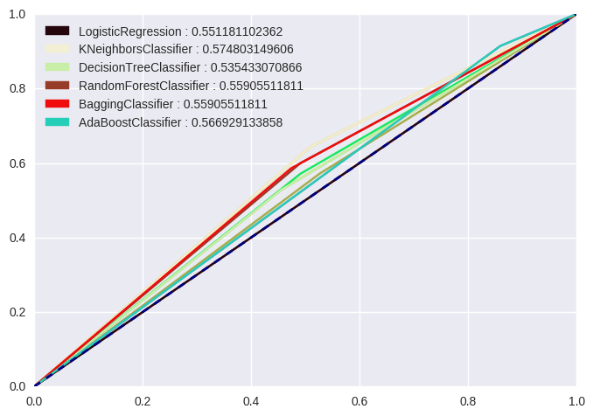
Model Performance
Using only net sentiment score:
Model | Accuracy | F1 | Precision | Recall
LogisticRegression | 0.551181 | 0.710660 | 0.551181 | 1.000000
KNeighbors | 0.574803 | 0.625000 | 0.608108 | 0.642857
DecisionTree | 0.535433 | 0.556391 | 0.587302 | 0.528571
RandomForest | 0.559055 | 0.600000 | 0.600000 | 0.600000
Bagging | 0.559055 | 0.594203 | 0.602941 | 0.585714
AdaBoost | 0.566929 | 0.699454 | 0.566372 | 0.914286
Kneighbors Classifier has the highest accuracy (0.5748)

Slide 22
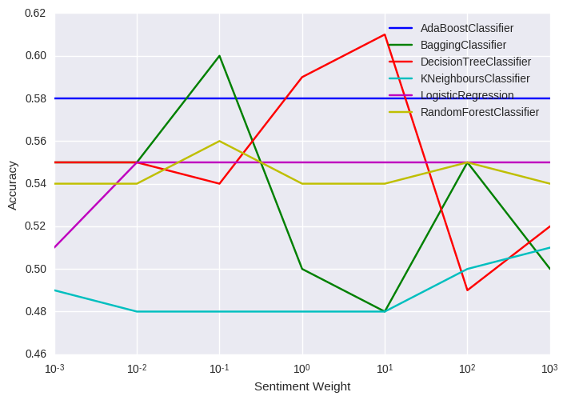
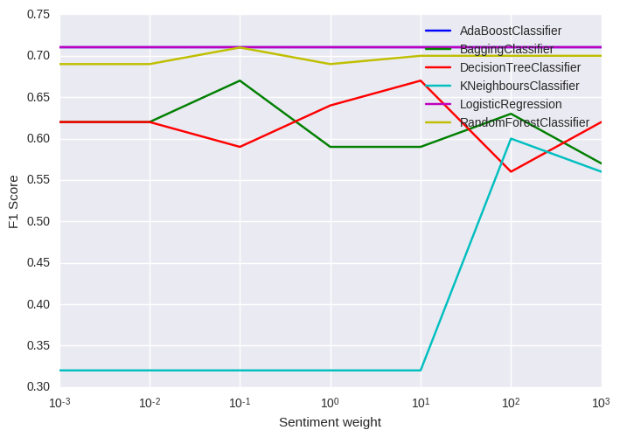
Plot of accuracy and F1 score with sentiment weight
Most of the models’ accuracy and F1 score vary with different sentiment weight
Accuracy and F1 score for AdaBoost and Logistic Regression stays the same with different sentiment weight

Slide 23
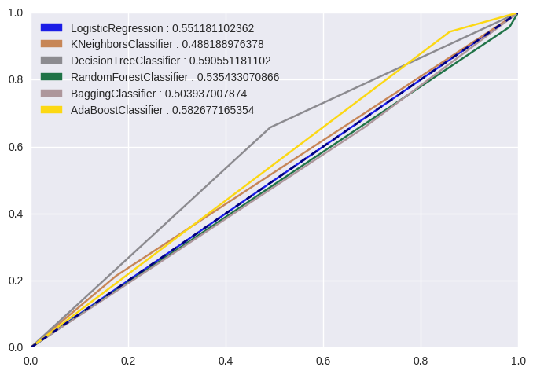
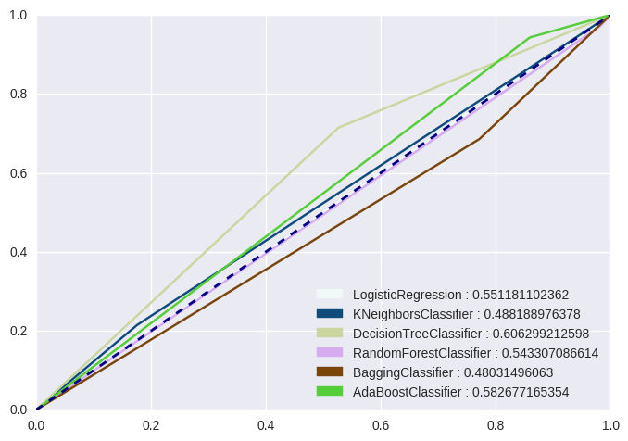
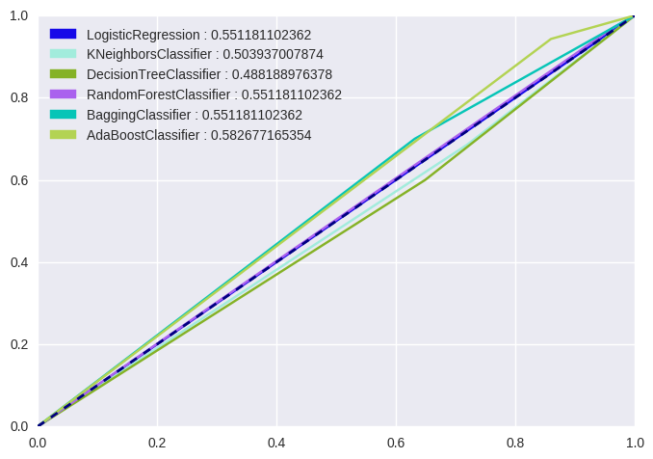
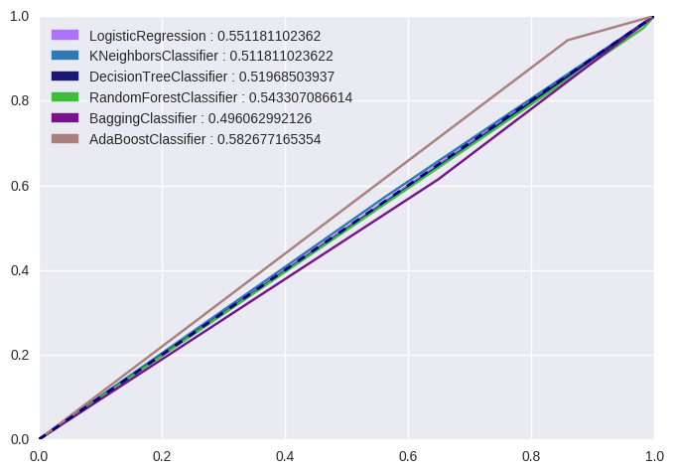
ROC curve with sentiment score
Using only net sentiment score:
W=1
W=10
W=100
W=1000
Decision classifier with best accuracy = 60 and sentiment weight( W ) = 10
AdaBoost Classifier perfoms second best but no shows no varaince with sentiment weight.

Slide 24

Conclusion

Slide 25
CONCLUSION
There is a lot of potential in utilizing machine learning techniques and text analytics to provide us insights in helping us to predict market prices.
The world of unstructured data has a huge potential in affecting stock prices as news tends to have an effect on the behaviour of the market.
Future work can be done in terms of collection of data to increase the accuracy of the classifiers as the current dataset simply takes the daily top 25 headlines which are not so helpful in gaining insights to predict stock movements.
Best model is Grid Search with 63% accuracy

Slide 26


Slide 27


